Slide 1

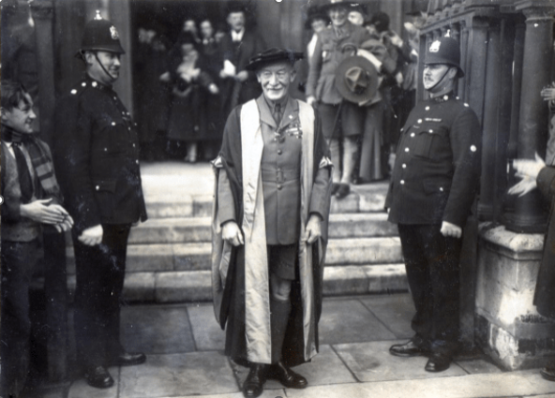
International Scouting
“If we are to have peace in the world, we must start by teaching children to be friends with those of other nations.”

Slide 2
George Devine
Manager, Global International Support Team
Manager, UK Africa Support Team
Involved in various International Community Service expeditions
Various Scout appointments including ACC (I) Cambridgeshire

Slide 3
Alistair Easterfield
Formerly ESL, Phoenix ESU, Cambridge
Have led Explorer trips to 10 different countries
Have co-led 5 other international Scout trips
School External Visits Coordinator
Have led international school trips

Slide 4
Initial planning -
Why do you want to go abroad?
Experience another culture?
International event?
Engage in an activity not available in UK?
Explorer Belt?

Slide 5
Initial planning – The next questions
Where?
How many?
Who? (volunteers and attendees)
How much?
When?
VA Form part A
Launch
Find a local contact

Slide 6
Further planning - Next steps
Transport
Accommodation
Programme
Activities
Insurance

Slide 7
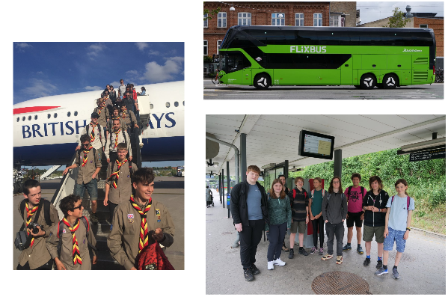
Further planning- Transport
Self drive
Hired vehicle
Public transport
Environmental impact
Skills for life
Collect copies of passports and GHICs

Slide 8
Further planning- Accommodation
Indoor/outdoor?
Scout Centre’s?
Campsites?
Hostels?
Hotels?
AirBnB?
Home hospitality

Slide 9
Further planning- Programme
Joint activities
Adventurous
Cultural
Allow rest and time to do things you discover there
Skills for life
Further planning- Adventurous
Self led?
Hired instructors? – allow time

Slide 10
Further planning- Paperwork
Part B VA form 6-8 weeks before departure
Risk assessment
Emergency contact list
Home contact
Prepare volunteers – delegate!
Have everything printed out (and back up)

Slide 11
When you’re there
Have copies of passports and GHICS
Keep hold of passports
Ensure medication is kept in hand luggage (not hold luggage)
Have a credit card with a large limit for emergencies

Slide 12
When you’re there
Don’t be afraid to change things
Eat out/try local food
Emergency contact cards
HAVE FUN!!!!

